Slide 1
Ordination Analysis of Veg Monitoring Plots

Slide 2
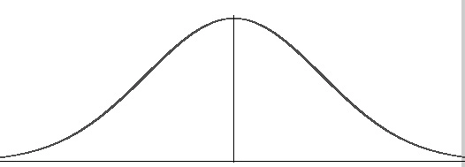
Detrended Correspondence Analysis
Why?
Reciprocal averaging
Plot scores calculated as weighted average (centroid) of species scores and vice versa, iterated until convergence
Avoids artefacts if species have unimodal distributions
Compare to: PCoA (distance matrix) or PCA (correlation coefficient matrix)
Species
abundance
Wet
Dry

Slide 3
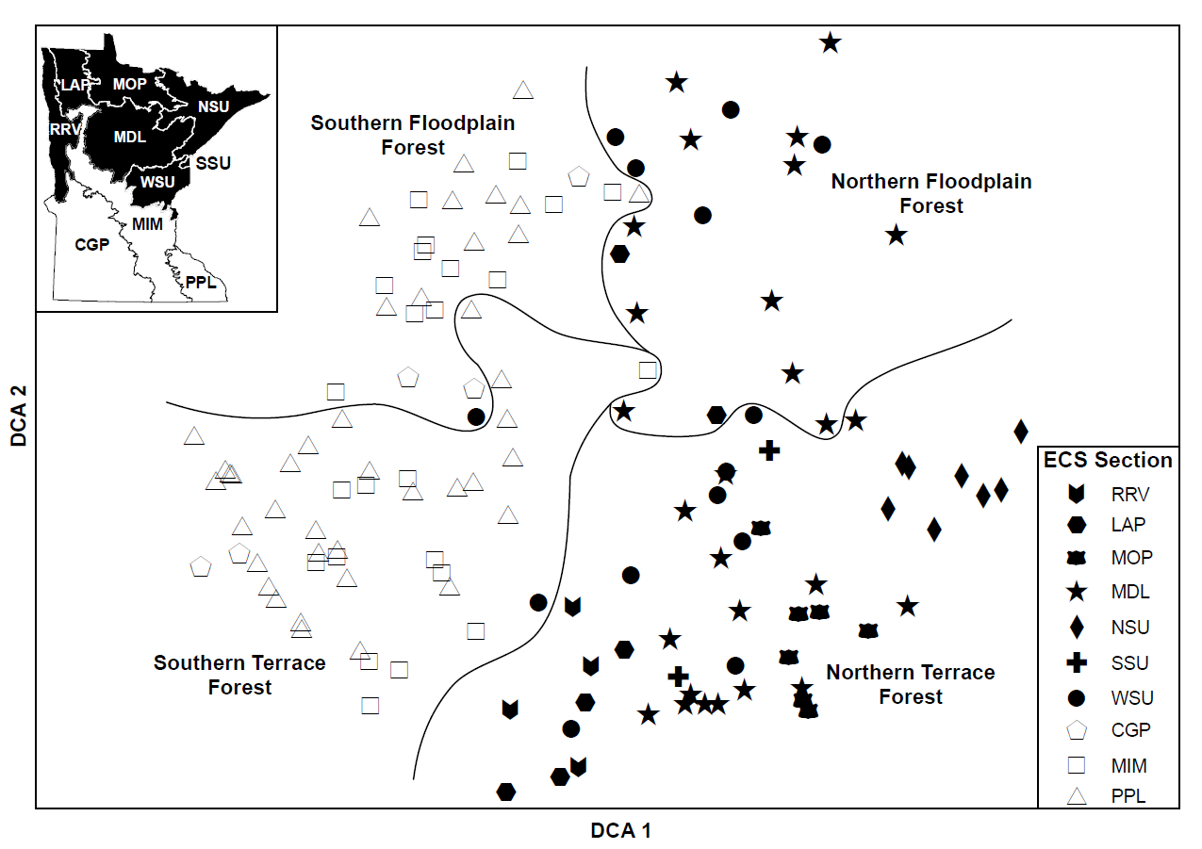
NPC Classification

Slide 4
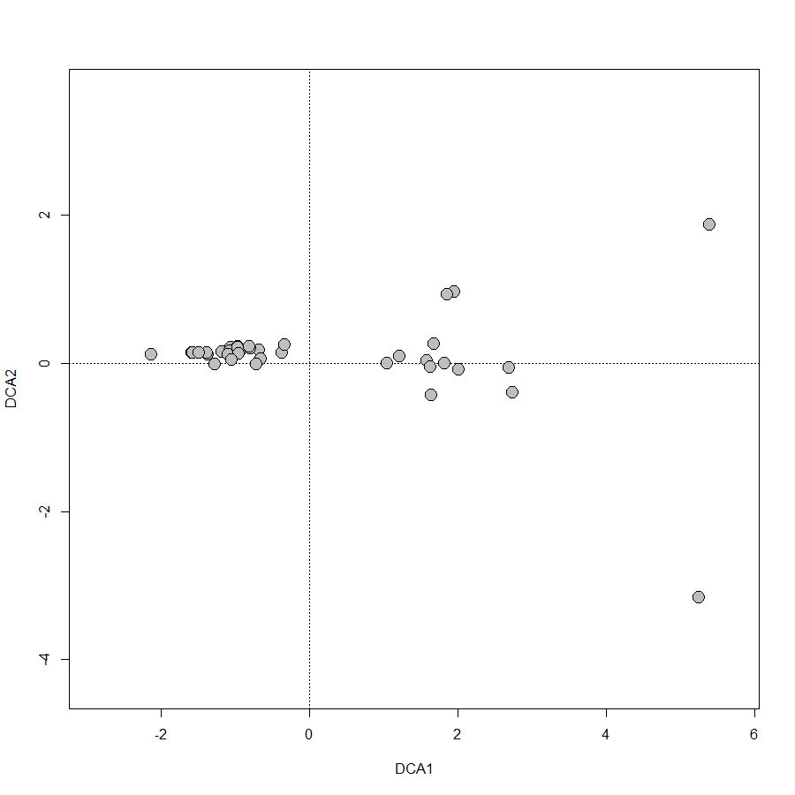

Slide 5
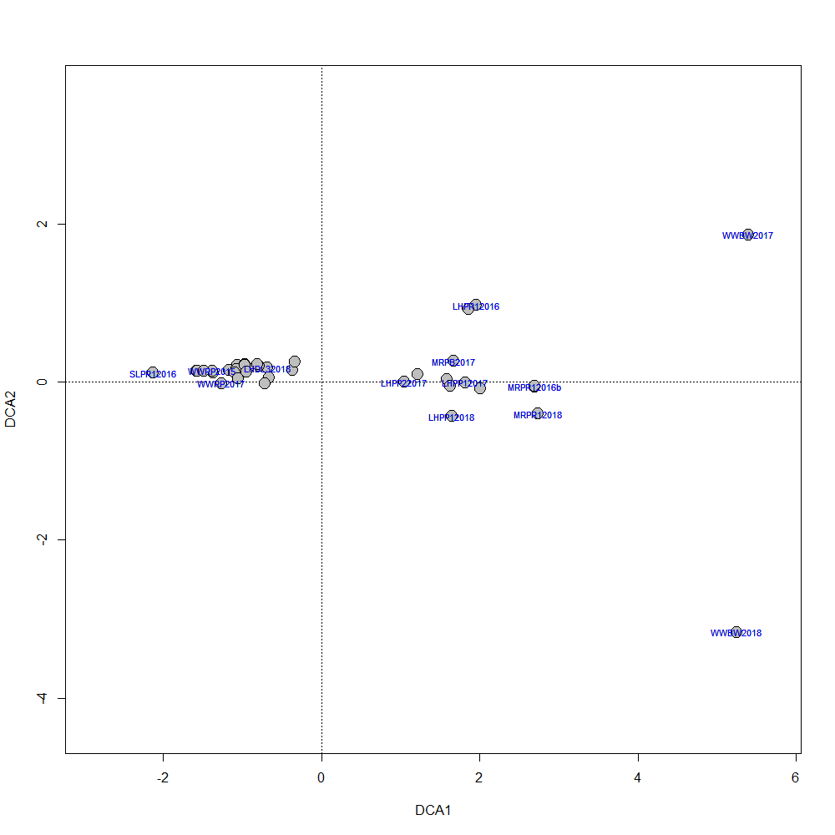

Slide 6
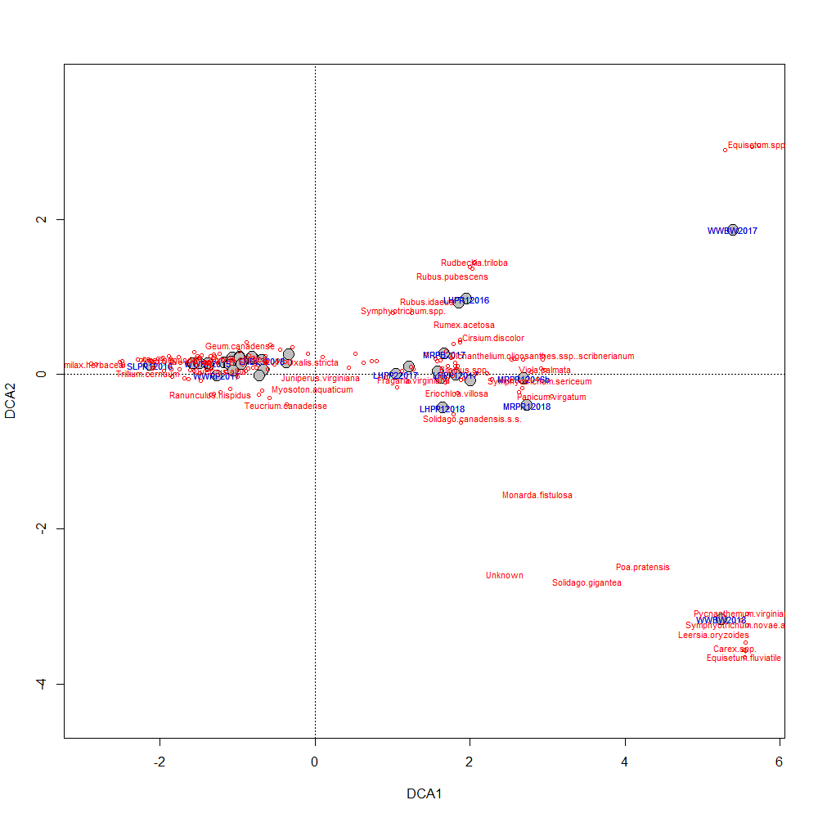

Slide 7
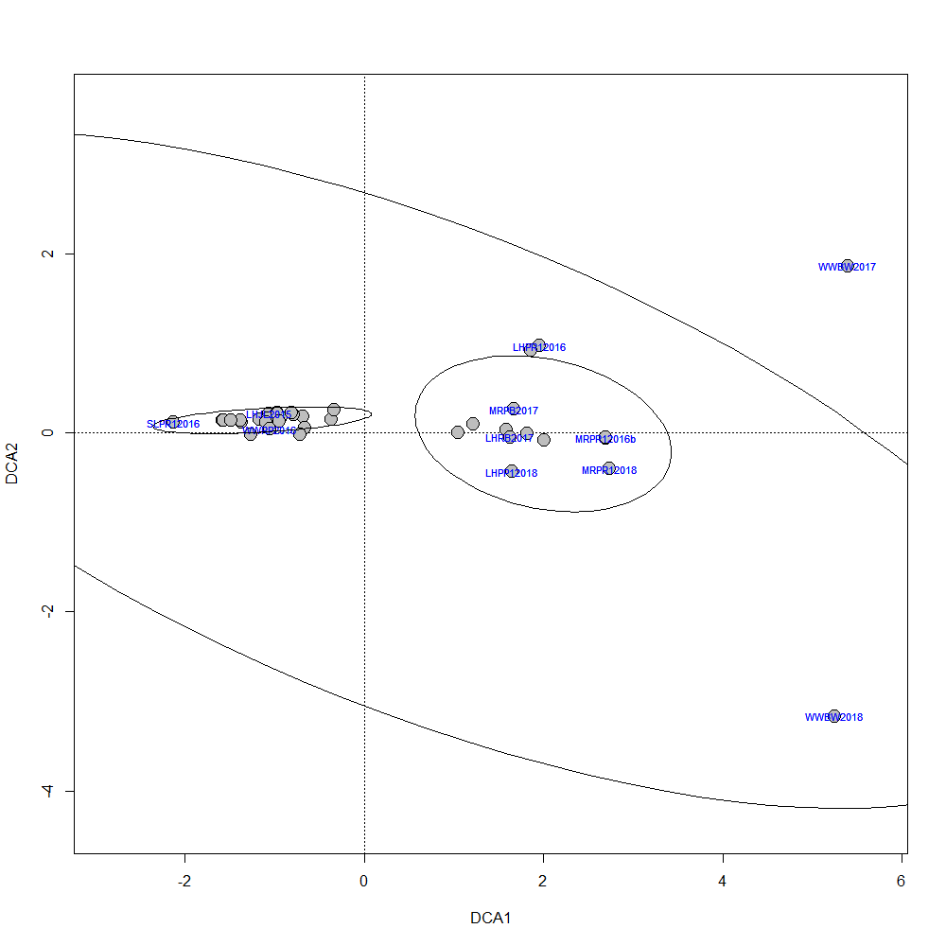
wetlands
woodlands
prairies

